Slide 1


The Class of 1964
Policy Research Shop
State of the Arts and Culture
An Economic Assessment of New Hampshire’s Arts and Culture Industries
PRS Brief 1516-07
May 2, 2016
Abigail Rohman, Amy Sun, Taylor Watson
This report was written by undergraduate students at Dartmouth College under the direction of professors in the Rockefeller Center. Policy Research Shop (PRS) students produce non-partisan policy analyses and present their findings in a non-advocacy manner. The PRS is fully endowed by the Dartmouth Class of 1964 through a class gift in celebration of its 50th Anniversary given to the Center. This endowment ensures that the Policy Research Shop will continue to produce high-quality, non-partisan policy research for policymakers in New Hampshire and Vermont.

Slide 2
The Class of 1964
Policy Research Shop
Contents
Background
Methodology
Data
Analysis
Conclusions

Slide 3
The Class of 1964
Policy Research Shop
Background
Ability of Policy to Promote or Burden the Arts
What Are the Coming Challenges and Opportunities?
What Can the State Do to Help?

Slide 4
The Class of 1964
Policy Research Shop
Methodology Defining the Creative Economy
Organizations of individuals who fit into either the core or peripheral aspects of artistic or cultural activities
Core: Pure artistic or cultural pursuit, e.g., Museums, Glassblowing, Woodworking
Peripheral: Involving or related to core industries specific to a region, e.g., Technology design, Bookbinding, Arts Supplies

Slide 5
The Class of 1964
Policy Research Shop
Methodology
Individuals
Non-Profit
Commercial
Qualitative
Quantitative
Challenges
Opportunities
Trends
Revenues in Economy
Tax Revenues
Employment

Slide 6
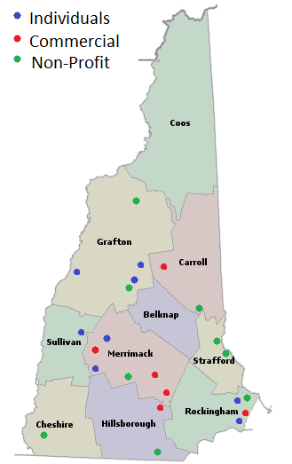
The Class of 1964
Policy Research Shop
Data
10 Non-Profits: Libraries, Museums, Performing Arts Centers, State Fairs, Galleries 8 Individual Artisans: Blacksmith, woodprint artist, eco-artist, carpenter, musicians, playwright, weaver 6 Commercial Enterprises: Galleries, Recording Studio, Concert Hall, Web Designer, Arena

Slide 7
The Class of 1964
Policy Research Shop
Analysis Overarching Impacts
Arts and culture industry functions in conjunction with the New Hampshire Division of Travel and Tourism
Arts and culture organizations help boost revenue and reputation
The economic impact of arts and culture enterprises are magnified through the use of technology

Slide 8
The Class of 1964
Policy Research Shop
Analysis Individual Artists
The role of arts organizations is pivotal
Network
Funding
Challenges of a rural state
In-state and out-of-state audiences
Economic, cultural, and societal impacts of individual artists

Slide 9
The Class of 1964
Policy Research Shop
Analysis Non-Profit
Attracting out-of-state and seasonal audiences
Tax code simplification and exemptions
Networks: digital, social, institutional

Slide 10
The Class of 1964
Policy Research Shop
Analysis Commercial
Maintain current tax policies
Maintain levels of out-of-state attendance
Bolster state interest in the arts

Slide 11
The Class of 1964
Policy Research Shop
Conclusions
Redistributive policy from audience beneficiaries to audience attractors
Expand Department of Travel and Tourism
Continue high-skilled workforce via design and media enterprise
Leverage web resources on geographic challenges

Slide 12
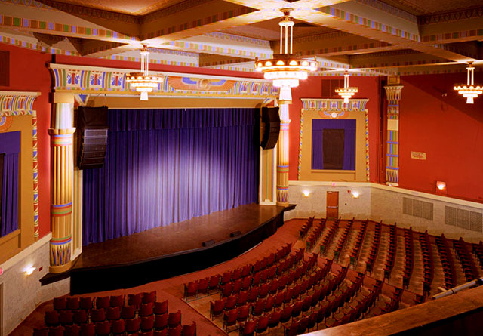
Questions?
“Our cultural organizations as well as individual artist are also educators who serve as businesses which power the growth of our economic future. A vital arts sector attracts businesses, neighbors and visitors to our cities and towns; ultimately strengthening a robust, appealing and sustainable foundation for our New Hampshire communities.” -Donnalee Lozeau, Mayor, Nashuan NH

